Slide 1
Introduction to the Research Framework
Work-in-progress
Conceptualizing the Criteria to assess ‘appropriateness’ of actions in given ‘national’ circumstances

Slide 2
Outline of the presentation
Introduction to the Project
  Project objectives
  Key Tasks
  Collaborators
Introduction to the Research Framework
  Is a framework require?
  If so, how will it be used?
  How do we develop it?

Slide 3
Objectives
To Identify of constituent elements defining the idea of ‘Nationally Appropriate Mitigation Actions’.
To study the level of preparedness of developing countries and assess their capacity enhancement needs to implement the NAMAs and to what extent regulatory, legal and institutional measures at domestic level can strengthen them.
To analyze international architecture for REDD Plus and its relevance for India

Slide 4
Work-packages
Work Package 1: Developing the criteria to assess ‘appropriateness’ of actions in given ‘national’ circumstances.
  Task 1.1: Conceptualizing the Criteria
  Task 1.2: Vetting the Criteria in Different Country Contexts
Work Package 2: Identify NAMAs in selected countries
  Task 2.1: Identification of Potential Mitigation Actions
  Task 2.2: Assessing Appropriateness of Potential Mitigation Actions
Work Package 3: Assess and enhance the preparedness of regulatory, policy and institutional arrangements in selected countries
  Task 3.1: Assessing Country Preparedness
  Task 3.2: Examining International Architecture
  Task 3.3: Enhancing Preparedness

Slide 5
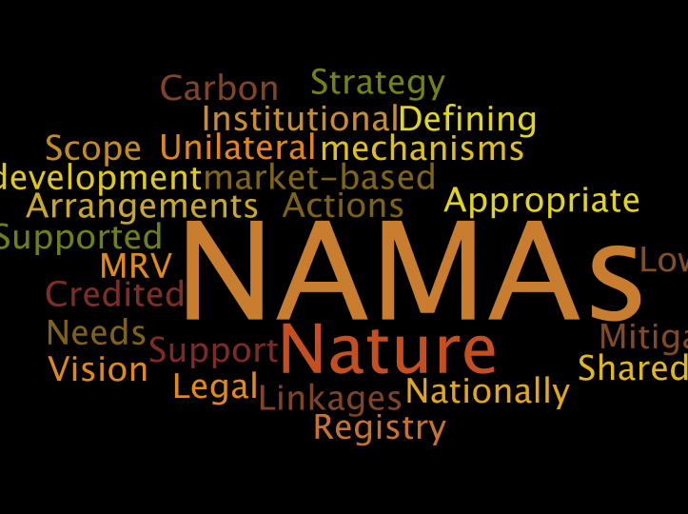

Slide 6
What does a NAMA entail ?
NAMA = Nationally Appropriate + Mitigation action
Mitigation Actions
A ‘good’ NAMA proposal is developed from within the country in a participatory process to gain /organise local commitments
-(Höne & Jung, 2010)
NAMAs
Nationally Appropriate
Key Questions :
What is National Appropriateness?
How to define/assess NA in NAMAs? Who defines/ assesses NA ?
How to make the process of identification of NAMAs more participatory ?

Slide 7
Problem-Perspective-Solution Nexus
Environmental problems are complex: high level of uncertainty; political in nature (Bardwell,1991)
  Same extends to climate change problem, especially mitigation
  Selection of appropriate mitigation options is further complex (Ramanathan, 1998)
Different ways of constructing the problem and different paths to solving it (Bardwell,1991)
  Availability of different mitigation options/choices. But, what is the best ? And the most appropriate ?
Resolving the climate change problem entails more than a technical solution; Requires a combination of social, economic, political, and institutional buy in(Solomon & Hughey, 2007)
  In the context of mitigation choices, how do we make it more inclusive & participatory ?

Slide 8
A Research Framework Required
Mitigation actions can range from purely technological to purely behavioural or as combinations
Policies, measures and instruments (read: NAMAs) are tools to trigger the implementation of mitigation actions
Instrument that works well in one country may not work well in another country with different social norms and institutions (IPCC, 2007)
  Policy-makers need to evaluate instruments before they make choice
  Role of other stakeholders & holistic perspective important given the nature of the problem
There are gaps in evaluation of climate policy instruments to select the most appropriate instruments (SYKE, 2007)

Slide 9
Objectives of the Research Framework
Identify constituent elements (environment, economic, technological, social.. more?) defining national appropriateness
Provide a common tool that could be used by all countries (similarity in approach), applicable to multiple sectors (flexible) and is futuristic (ex ante evaluation)
Facilitate policy-makers in selecting the most ‘appropriate’ mitigation action from a broad spectrum of choices
  Could be applied in making ex-ante choices of mitigation actions and in ex-post evaluation of the performance of mitigation actions
  But, not an alternative to the normal policy process rather a tool to inform policy process
Enable prioritization of identified options or NAMAs ? Enable classification of NAMAs ?

Slide 10
Methods and approach
Multi Criteria Decision Making methods & tools (MCDM) have become increasingly popular in decision-making and have been applied to a wide range of environmental problems
Considered appropriate for complexity of the problem and multi perspectives of the environmental sustainability goal (Phekar & Ramachandran, 2003; Greening & Bernow , 2004; Solomon & Hughey, 2007; Wang et al, 2009)
Provides participatory analysis and qualitative assessment, complete environmental and socio-economic impact assessment approach (Browne & Ryan, 2010)
MCDM helps decision making by making key considerations, explicit in policy-making process

Slide 11
Approach
Decision Goals
Mitigation option
zz
Where we are ?
Selection of criteria
  Lit review/stakeholder
Next steps …
Consultations/survey
  Formalizing the criteria
Selection of criteria
Expert consultations/interviews
Literature Review
Determination of the weights
Expert consultations/interviews
Questionnaire survey
Assessing the options
Expert consultations/interviews
Questionnaire survey
Prioritized Actions NAMAs

Slide 12
Literature review
Four principal criteria for evaluating environmental policy instruments (IPCC 2007):
  Environmental effectiveness – the extent to which a policy meets its intended environmental objective or realizes positive environmental outcomes.
  Cost-effectiveness – the extent to which the policy can achieve its objectives at a minimum cost to society.
  Distributional considerations – the incidence or distributional consequences of a policy, which includes dimensions such as fairness and equity, although there are others.
  Institutional feasibility – the extent to which a policy instrument is likely to be viewed as legitimate, gain acceptance, adopted and implemented.
But, not necessarily ‘appropriateness’…

Slide 13
Discussions

Slide 14
Lit review: How does FCCC define NA?
Art 3.2 : ‘specific needs and special circumstances of developing country Parties...’
Art 3.4 : ‘... Policies and measures... should be appropriate for the specific conditions of each Party and should be integrated with national development programmes, taking into account that economic development...’
Art 4.1 : ‘All Parties, taking into account their... specific national and regional development priorities, objectives and circumstances’
Art 4.1 (f) : ‘employ appropriate methods... formulated and determined nationally’

