Slide 1
Nationally Appropriate Mitigation Actions
What Could “Nationally Appropriate” Entail in an Indian Context
Srinivas K, & Tirthankar Mandal, CANSA, New Delhi, 11th Aug, 2011

Slide 2
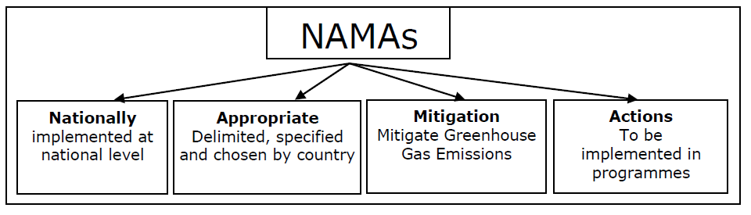
Evolution of “NAMA”
Emerged in 2007 under the Bali Action Plan
NAMAs promised to serve as a bridge between developed and developing country parties, following the principle of, ‘common but differentiated responsibilities’.
The Copenhagen Accord focused significantly on NAMAs, but many questions remained unanswered. A new term for MRV of NAMAs emerged – ICA
The Cancun Agreement in 2010, provided a schedule for establishing guidelines for measuring reporting and verification.
also decided to establish a registry for matching NAMAs and support,
and to create a fund for financing mitigation and adaptation actions, including new technology transfer mechanisms

Slide 3
“Nationally Appropriate” : Some Basic Principles
NAMAs to be guided primarily by the national priorities of social and economic development including the energy needs of people and the eradication of poverty
Not compromise on Growth and development – would promote “inclusive growth”
NAMA Plans to be developed by a “Bottoms-up Approach” to ensure that the needs of communities are factored into the plans
NAMA Plans to lead to a Long Term Low carbon pathway and vision

Slide 4
A Possible Illustration
GHG Emission
BAU Pathway
Developed country support
NAMA P1: Unilateral
Finance
NAMA P2: Supported
Technology
Year
Sustainable Dev

Slide 5
CAN’s views on NAMAs
Developing country NAMAs also play a very crucial role in addressing the giga-tonne gap.
BUT NAMAs are not there to fill the gap between Annex 1 pledges and the goal of maintaining temperature rise of less than 2⁰C.
A number of developing countries have far higher potential to reduce their emission levels than what has been announced.
Ambition levels are tied to strong domestic action and support, therefore NAMAs need to make a clear distinction between unsupported actions and supported actions.
NAMA plans of developing countries should be integrated in to a long term low carbon development pathway.

Slide 6
Issues that Need to be resolved immediately
Many developing countries are already taking substantial mitigation effort. Accelerated action, enabled with support, is urgently needed and possible.
Clear and common guidelines for NAMAs should be adopted
Develop common guidelines for methodologies and assumptions underpinning the definition of BAU
Develop a clear plan showing how support - financial, technological and capacity building – will be provided for the development and implementation of NAMAs, as well as a system of MRV for support.
Notes:
In many cases developing countries are taking substantial mitigation effort. Accelerated action is urgently needed and possible. It must be enabled with support. In order to strengthen and deepen these efforts, CAN makes the following recommendations:
Clear and common guidelines for the development of NAMAs to enhance the understanding of developing country action should be adopted as recommendations at the Durban COP/CMP.
Parties should make submissions and plan a workshop on the development of common guidelines for methodologies and assumptions underpinning the definition of BAU, this is necessary for a robust assessment of the overall effort and environmental integrity of the combined effort of Parties.
A clear plan showing how support - financial, technological and capacity building – will be provided for the development and implementation of NAMAs must be developed, as well as a robust system of MRV for support.
A work programme should commence for the development of the registry and a robust MRV system to ensure both are operationalised at Durban – enabling recognition of early action and matching enhanced action with support.
A number of parties presented ways in which they were locating their NAMAs within longer-term low emission plans for their countries; parties should create the opportunities within next sessions to explore this further. This should be with a view to creating an architecture where NAMAs can be developed within the context of long-term Low Emission Development Strategies (LEDs) / Plans (2050) mentioned in paragraph 65 of the decision listed in FCCC/CP/2010/7/Add.1

Slide 7
What Could Be Nationally Appropriate from an Indian Context
Addressing the Issue of Energy Poverty and linking energy to Livelihoods
Aggressive deployment of renewable energy solutions could address the issue of energy scarcity and also ensure energy access. A 15% RE by 2020 target of NAPCC, could translate to

Slide 8
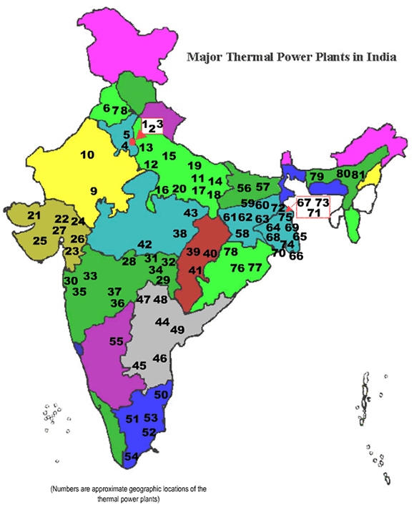
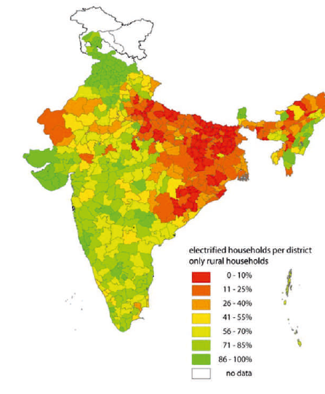
Comparative Map of India with Thermal Power Plants and level of household electrification

Slide 10
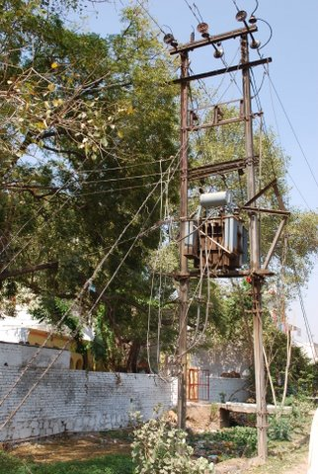
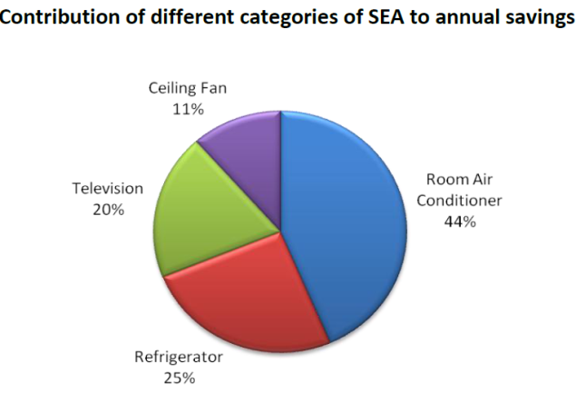
Energy Efficiency Improvement
India has the dubious record of being on the top slot of countries with regard to Transmission & Distribution losses, which are 5-6 times more than the global average
Shifting to just end use appliances to highly efficient could avoid 20,000 MW of peak demand and save 60 tWh of electricity by 2020 with 48 million tonnes of avoided CO2 (Prayas report)

Slide 11
Opportunities for the 12th Plan
The 12th Plan Strategies as outlined are as follows:
  Enhanced Growth
  Enhancing skills and faster generation of employment
  Market development and market access and linking it to rural transformation and sustained growth of agriculture
  Securing Energy Future
  Accelerated development of transport infrastructure
All of these together present an unique opportunity for India to opt for a low carbon pathway
These could be truly “Nationally Appropriate” as it also fits into the Government’s priority areas
Low carbon options will be expensive – but NAMA plans can reflect the need for additional resources

Slide 12
Thank You

