Slide 1

Brazil basics
Gaines Campbell

Slide 2
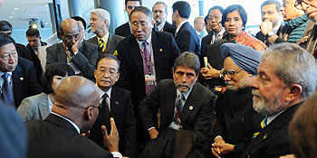
BASIC points
More important as grow
Aligned with G77
Demanding more ambition A1
Similar and Different
Notes:
As they grow the BASIC, will have increasingly important role in climate regime negotiations
Aligned with G77 and insist on differentiation of responsability for GHG emissions reductions and maintain firm demand for more ambition form developed countries
Major diferences in national circumstances and drivers may push them apart, shared political will and compromise can keep them together

Slide 3
Similar and diferent
Cumulative historical emissions (1850 – 2006)
Current annual emissions (2005)
Current per capita GHG emissions(2005) t CO2 eq

Slide 4
National circumstânces for NAMAs
GHG Emissions Brazil -2005
Primary Energy Production
Non-renewable | Petroleum | 101
 | Gas | 21
 | Others | 6
 | total | 128 | 0,53
Renwable | Hydrolic | 33
 | Sugar cane products | 45
 | Others | 34
 | Total | 112 | 0,47
 | Grand total | 240
Source: Second National Communication
10³ toe – tons of oil equivalent (2010)

Slide 5
Brazil´s approach to climate negotiations
Historical responsibility approach
No quantified targets for non-Annex I countries
. "We will not hide behind any country and no country will be able to hide behind us,"
  Celso Amorim, Former Min. Foreign Relations

Slide 6
Brazil´s positions on NAMAs
NAMAs are actions resulting in direct emissions reductions
NAMAs are diferent than Annex 1 Targets
Transnational and national sectorial targets inappropriate for developing countries
NAMAs should be proposed on a voluntary basis and require finanancial and technology transfer
MRV should be applied both to the NAMAs and the support
  National procedures for M and R, international for V

Slide 7
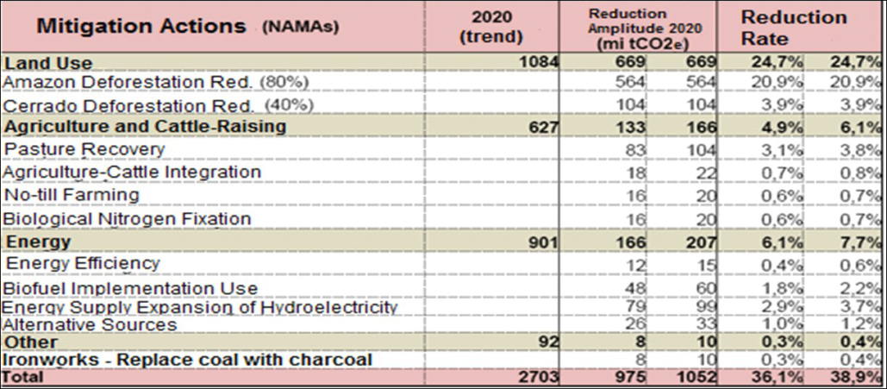
Potencial NAMAs for Brazil
14% potencial reduction against BAU by 2020 in:
  Transport
  Power
  Industrial
Reduced emisions deforestation and degredation very big potential

Slide 8
Obrigado
Sources:
  Together Alone?
    Stockholm Environment Institute
  Climate Law
    Brazil
  Brazil Second National Communication to the UNFCCC
  Brazil 2010 National Energy Balance
  Climate Change Scientific Assessment and Policy Analysis, Nationally appropriate mitigation actions (NAMAs) in Developing Countries
    Netherlands Environmental Assessment Agency

