Slide 1
Introduction to Green Building Profession
Skill Training & Management
First step to becoming a Green Building Professional

Slide 2
Structure of the coursework:
The course is divided into 2 modules:
Metrics of Sustainability
Module 2
How to gain Green Experience?
Module 1
Stakeholders in Sustainability
Green Building Professions
Sustainable design – The process
Preparing the “Green Work Force”
Forecast for the future
Range of Roles – Sustainability and Green Building Consultants
Key environmental issues addressed by Green Building consultants

Slide 3
Module 1
Metrics of Sustainability
Stakeholders in Sustainability
Preparing the Green Work Force
Forecast for the future
Green Building Professions
Sustainable design – The process

Slide 4
Sustainable design as a well conceived process
Awareness and sensitivity to the environment and environmental challenges.
Knowledge and understanding of the environment and environmental challenges.
Attitudes of concern for the environment and motivation to improve or maintain environmental quality.
Skills to identify and help resolve environmental challenges.
Participation in activities that lead to the resolution of environmental challenges.

Slide 5
Metrics of Sustainability
Standards
  Mandatory
  Voluntary
Rating Systems

Slide 6
Metrics of Sustainability
Standards
  National Building Code
  Model Building Byelaws
  Energy Conservation Building Code
  Eco-Niwas Samhita

Slide 7
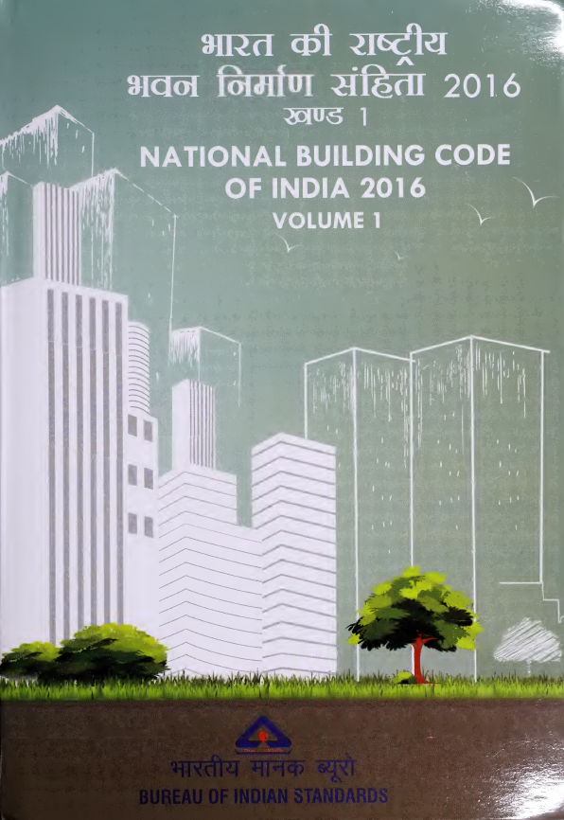
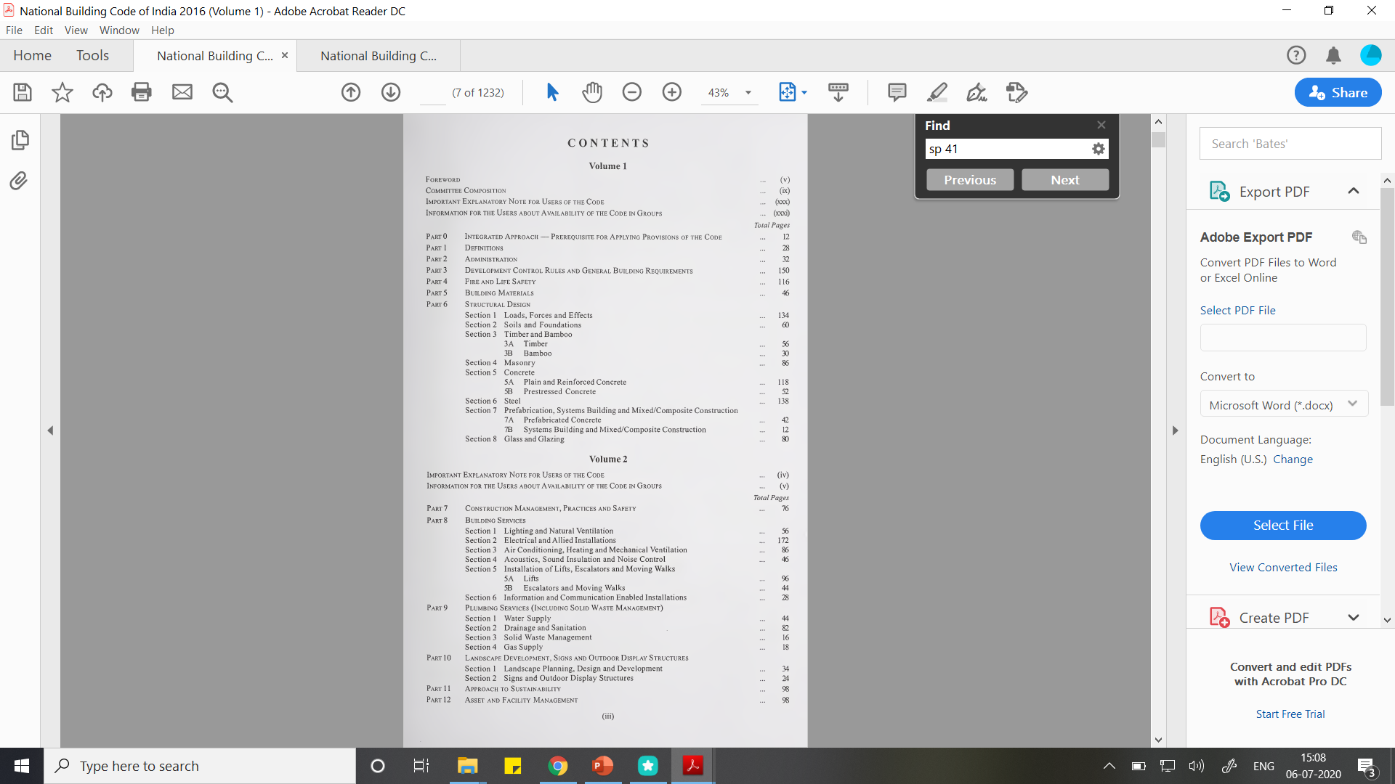
National Building Code

Slide 8
National Building Code

Slide 9

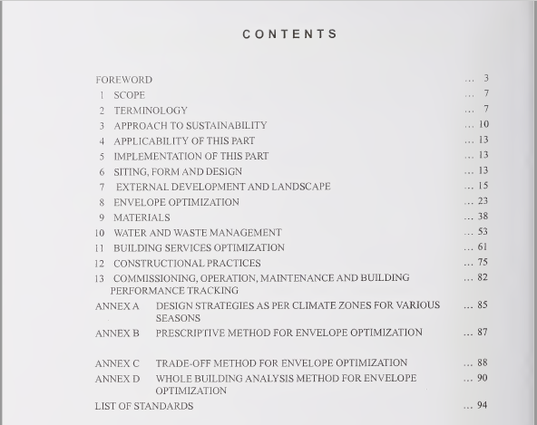
National Building Code
The approach to sustainability is founded in the principles of Code to adequately protect public health, safety and welfare, and to meet requirements that do not unnecessarily increase construction-cost nor restrict the use of new innovative materials, products or methods of construction.

Slide 10
National Building Code
With a view to boost sustainability, the building code for the first time includes process for glazing in buildings with respect to their effect on energy, light and selection and manifestation of glass with respect to safety. It also focuses on energy conservation, use of solar energy by way of solar water heating systems, solar steam systems for cooking and laundry, solar-assisted refrigeration/air conditioning systems, solar photo voltaic systems, and efficient lighting.

Slide 11
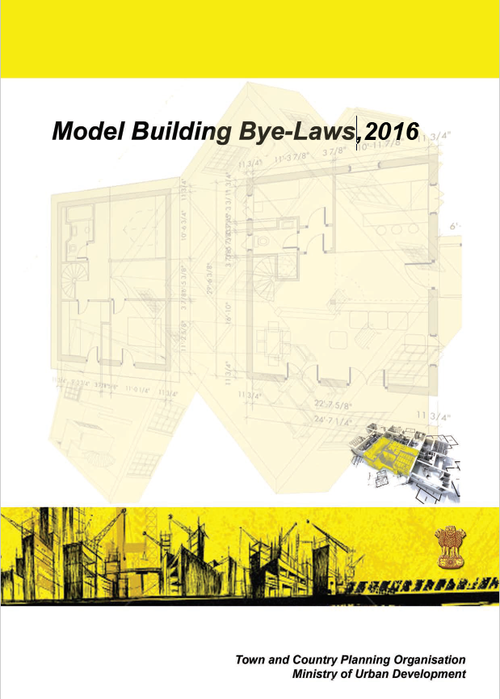
Model Building Bye-Laws
Model Building Byelaws, 2016 are legal tools used to regulate coverage, height, building bulk, and architectural design and construction aspects of buildings so as to achieve orderly development of an area.

Slide 12
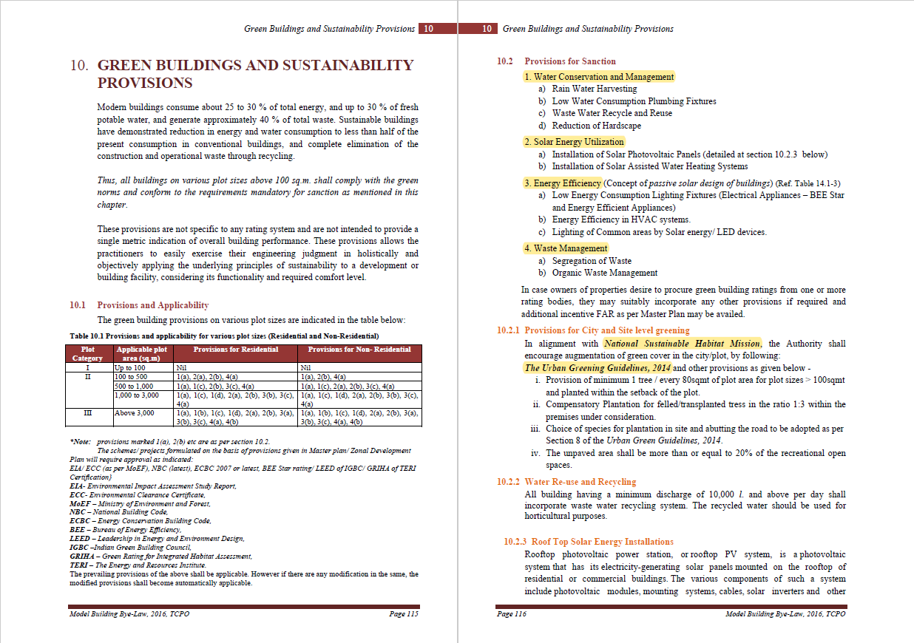

Thank you!
Ar. Prajna Aigal
Research Associate, Sustainable Buildings
The Energy and Resources Institute
prajna.aigal@teri.res.in

Slide 13
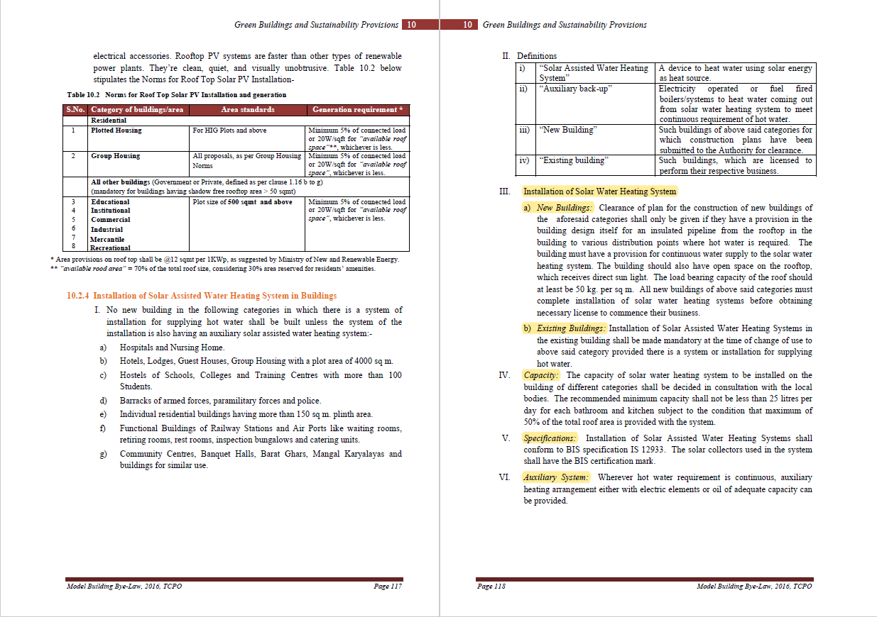
Thank you!
Ar. Prajna Aigal
Research Associate, Sustainable Buildings
The Energy and Resources Institute
prajna.aigal@teri.res.in

Slide 14
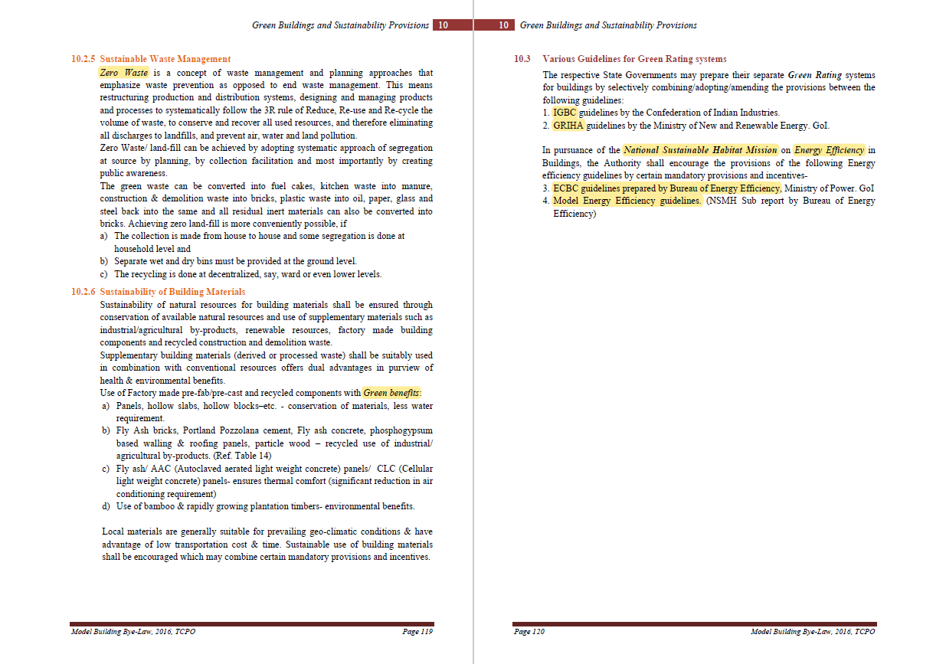
Thank you!
Ar. Prajna Aigal
Research Associate, Sustainable Buildings
The Energy and Resources Institute
prajna.aigal@teri.res.in

Slide 15
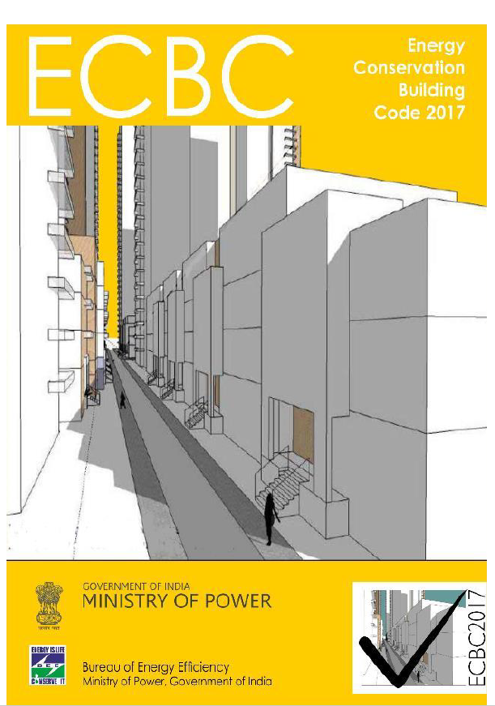
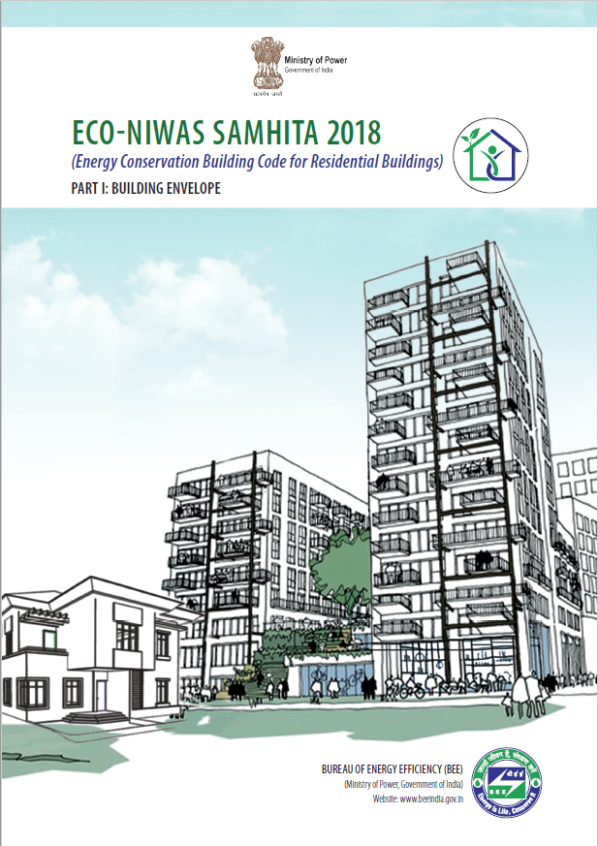
Energy Conservation Building Code and Eco NIWAS Samhita

Slide 16
Metrics of Sustainability
Common core factors between rating systems:
  Location, site features & building orientation
  Water efficiency
  Energy efficiency
  Material and resource selection/reduction
  Indoor air and environmental quality
  Toxin reduction / elimination
Rating Systems:
  GRIHA
  LEED
  IGBC
  EDGE
  GEM

Slide 17
Green Building Professions
Academic
Architect
Building owner
Chief sustainability officer
Civil engineer
Commissioning agent
Contractor
Electrical engineer
Environmental consultant
Facility manager
Interior designer
Landscape architect
Mechanical engineer
Non-profit member
Plumbing engineer
Real estate professional

Slide 18
Stakeholdership in Sustainability
Owner
Community Manager
Facility Manager
Planning Staff
O&M Staff
Cost Estimator
MEP Contractor
General Contractor
Construction Manager
Product Manager
Daylighting/Energy Analyst
Commissioning Agent
Landscape Architect
Civil Engineer
Planner
Architect
Structural Engg.
MEP Engineer
Building Users
Courtesy: The Integrative Design Guide to Green Building: Redefining the Practice of Sustainability, Authored by Bill Reed and 7group
Adapted from: Graphic by Bill Reed

Slide 19
Entire project as
learning wheel
What do we believe?
REFLECTING
Pre-Project
Organizational context
Assemble right team
Right charge to team - Goals
Team alignment
What do we know?
CONNECTING
Discovery
Data gathering: site, project.
I.D. key systems
Baseline traditional design and budget
Owners vision and design intent
REFLECTING
What do we believe?
CONNECTING
What do we know?
DECIDING
Barriers & measures to overcome
DOING
Whole systems processes
TTCB mindset
Team alignment
Specific goals
Sust. Principles
Digestion
Catalyst
Inhibitors
Opportunities & Solutions
Brainstorm
Cross-link
Solutions filtering
Business cases
Coordinated action on design iterations
Past Projects
-Collect Data
-Analyse in-use realty
-Refine operations
DECIDING
Finalizing Design
Final business cases
DOING
Constructing
Follow through
DIAGRAM OF THE LEARNING WHEEL. ADAPTED FROM IDEAS PRESENTED IN PETER M. SENGE ET AL., THE FIFTH DISCIPLINE FIELDBOOK: STRATEGIES AND TOOLS FOR BUILDING A LEARNING ORGANIZATION

Slide 20
How do you best prepare young professionals for the green work force?
Encourage the application of sustainable and restorative research to studio projects.
Provide research, collaboration, and hands-on building opportunities that encourage multidisciplinary collaboration and sustainable building.
Incorporate new scholarship, research, and practice in the coursework to better enable students to contribute to the further advancement of the discipline.

Slide 21
Forecast for the future in the field of sustainability
Continuous improvement in our understanding of sustainability and our effectiveness in achieving it;
Continued shift in the priorities in all students and faculty to hold sustainability as a core measure of a design's effectiveness, along with things like cost, constructability, aesthetics, and functionality;
Shift in emphasis from sustainability to regenerative design;
Expansion of the scale that is addressed in green building to look at whole cities and regions.

Slide 22

  What are the different metrics of sustainability?
  Who are the various green building professions?
  Who are the stakeholders in sustainability?
  Preparing the Green Work Force
  Forecast for the future
Module 1

Slide 23
Structure of the coursework:
The course is divided into 2 modules:
Metrics of Sustainability
Module 2
How to gain Green Experience?
Module 1
Stakeholders in Sustainability
Green Building Professions
Sustainable design – The process
Preparing the “Green Work Force”
Forecast for the future
Range of Roles – Sustainability and Green Building Consultants
Key environmental issues addressed by Green Building consultants

Slide 24
Module 2
Range of Roles – Sustainability and Green Building Consultants
Key environmental issues addressed by Green Building consultants

Slide 25
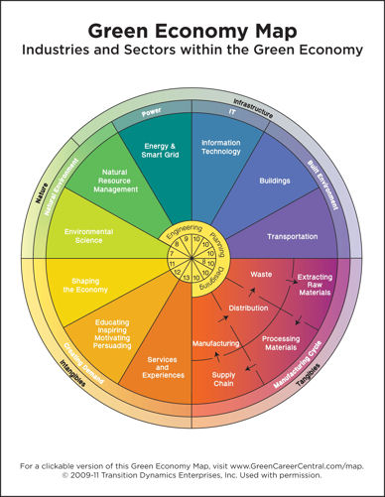
Courtesy: GreenCareerCentral.com
Source: https://www.3blmedia.com/News/Transitioning-Greener-More-Sustainable-Career-Experts-Provide-How-Advice-During-Webinar-Hosted

Slide 26
Range of Roles
Sustainability consultants
Green Building consultants

Slide 27
Range of Roles – Sustainability Consultants
Assessments
Provide gap analysis (a status report that looks at where a company is and where it wants to be) of current company with recommended action steps.
Assess energy sources and use, review the supply chain, and look at operation audits.
Research/analysis, such as benchmarking of competition or trends in the market.
Finance for green strategies.

Slide 28
Range of Roles – Sustainability Consultants
Plans
Provide sustainability plans/assessments/reporting.
Strategize for green change management/employee engagement.

Slide 29
Range of Roles – Sustainability Consultants
Reports
Recommendations for internal and external communication
Training/presentation to internal staff on sustainability goals
Advising internal chief sustainability officers (CSOs)

Slide 30
Range of Roles – Sustainability Consultants
Facilitate the vision/goal-setting with the owner in terms of the environmental aspects of the building.
Help with site selection based on environmental issues such as regional resources (water, renewable energy, etc.), urban infrastructure, and site conditions.
Determine if it would make more sense to utilize an existing building or to build new.
Assist in optimum team selection with specialized expertise based on project goals.
Recommend building orientation to best capitalize on natural resources such as maximizing daylighting.

Slide 31
Key environmental issues addressed by Green Building consultants
Site Issues
Water
Energy
Materials
Air
Awareness/Facilitation/Implementation

Slide 32
Key environmental issues addressed by Green Building consultants
Site Issues:
  Heat Island Effect
  Brownfield Remediation

Slide 33
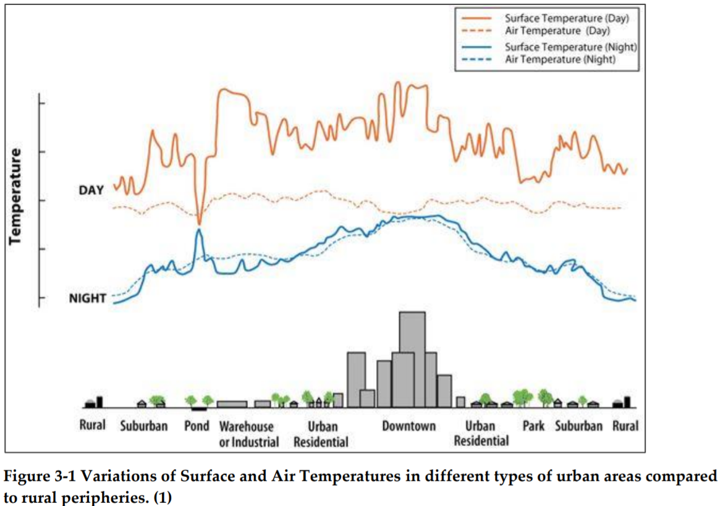
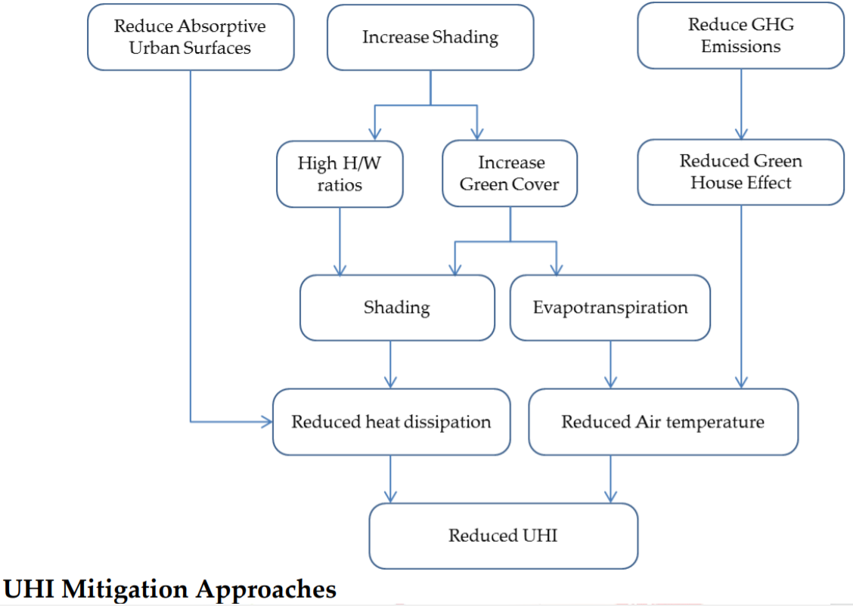
Site Issues: Urban Heat Island Effect

Slide 34
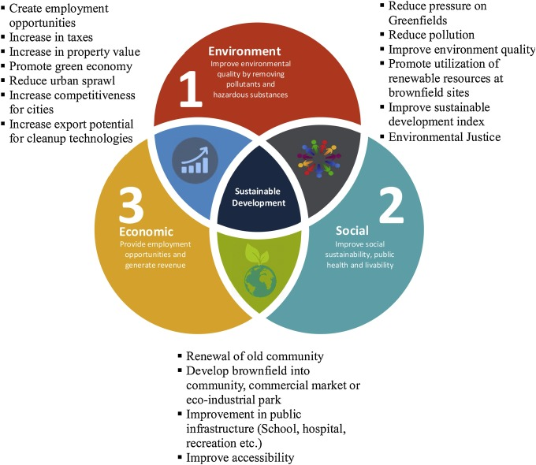
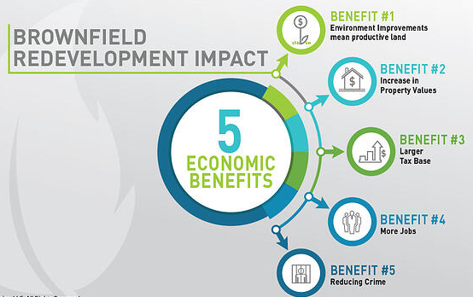
Site Issues: Brownfield Remediation

Slide 35
Key environmental issues addressed by Green Building consultants
Water:
  Rainwater Harvesting
  Resource Management

Slide 36
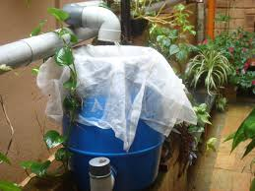
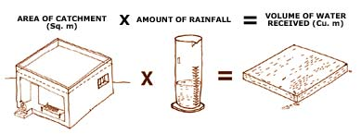
Water: Rainwater Harvesting

Slide 37
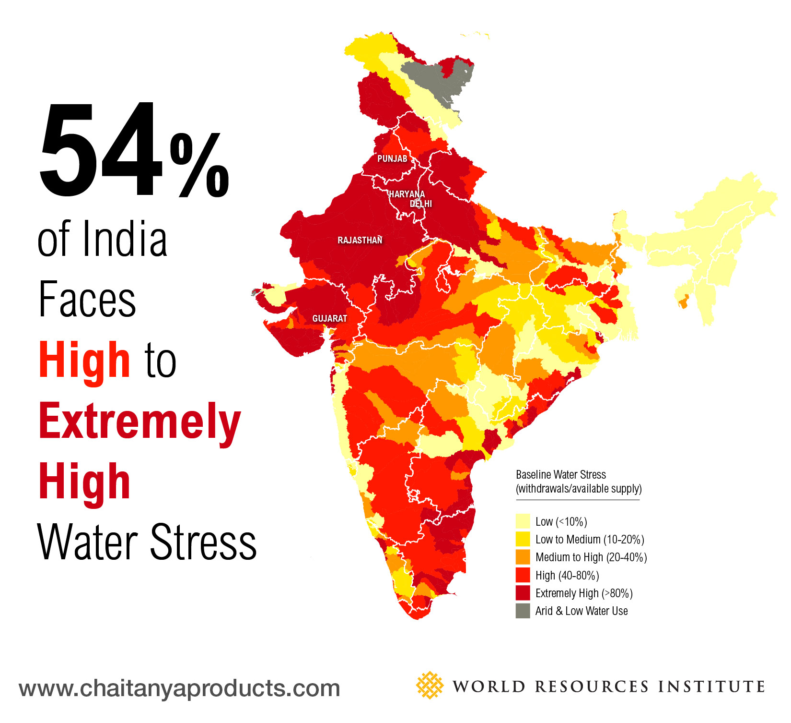
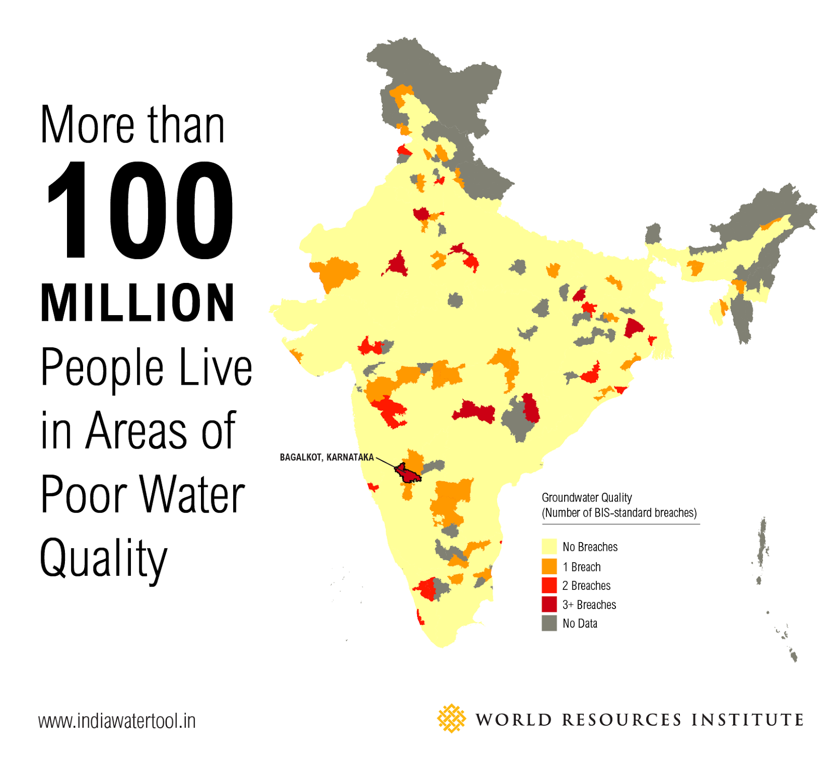
Water: Resource Management

Slide 38
Key environmental issues addressed by Green Building consultants
Energy:
  Energy Modelling
  Daylight Design
  Energy Audits
  Building Automation Systems

Slide 39

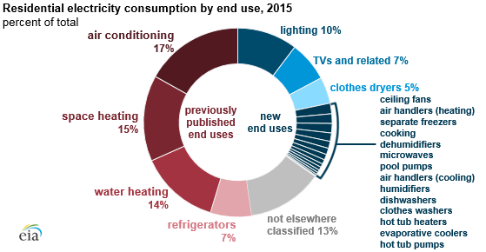
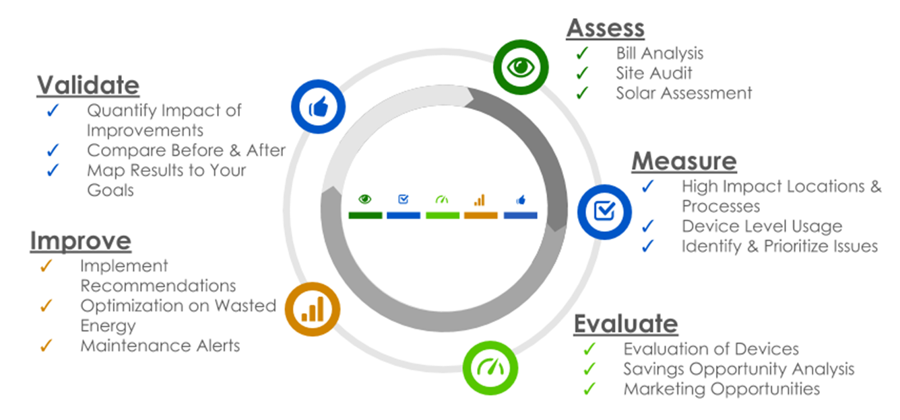
Energy: Energy Modelling

Slide 40
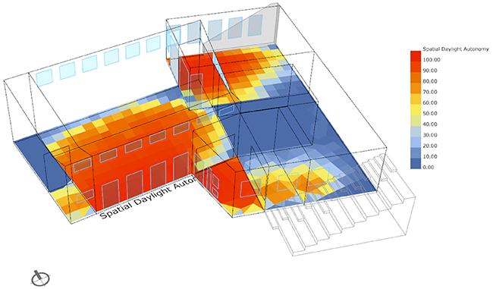
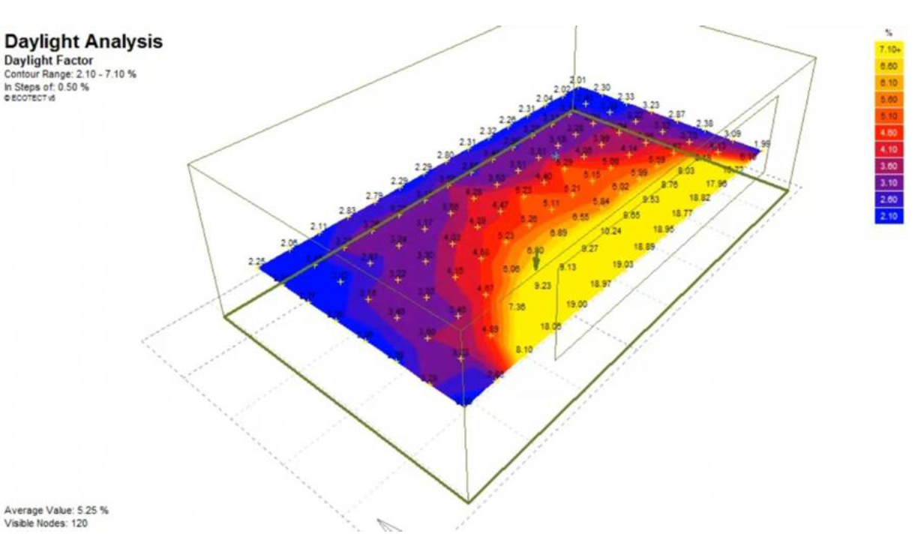
Energy: Daylight Design

Slide 41
Key environmental issues addressed by Green Building consultants
Future of Energy:
  Net-Zero Energy Building
  Carbon Neutrality
  Green power integration

Slide 42
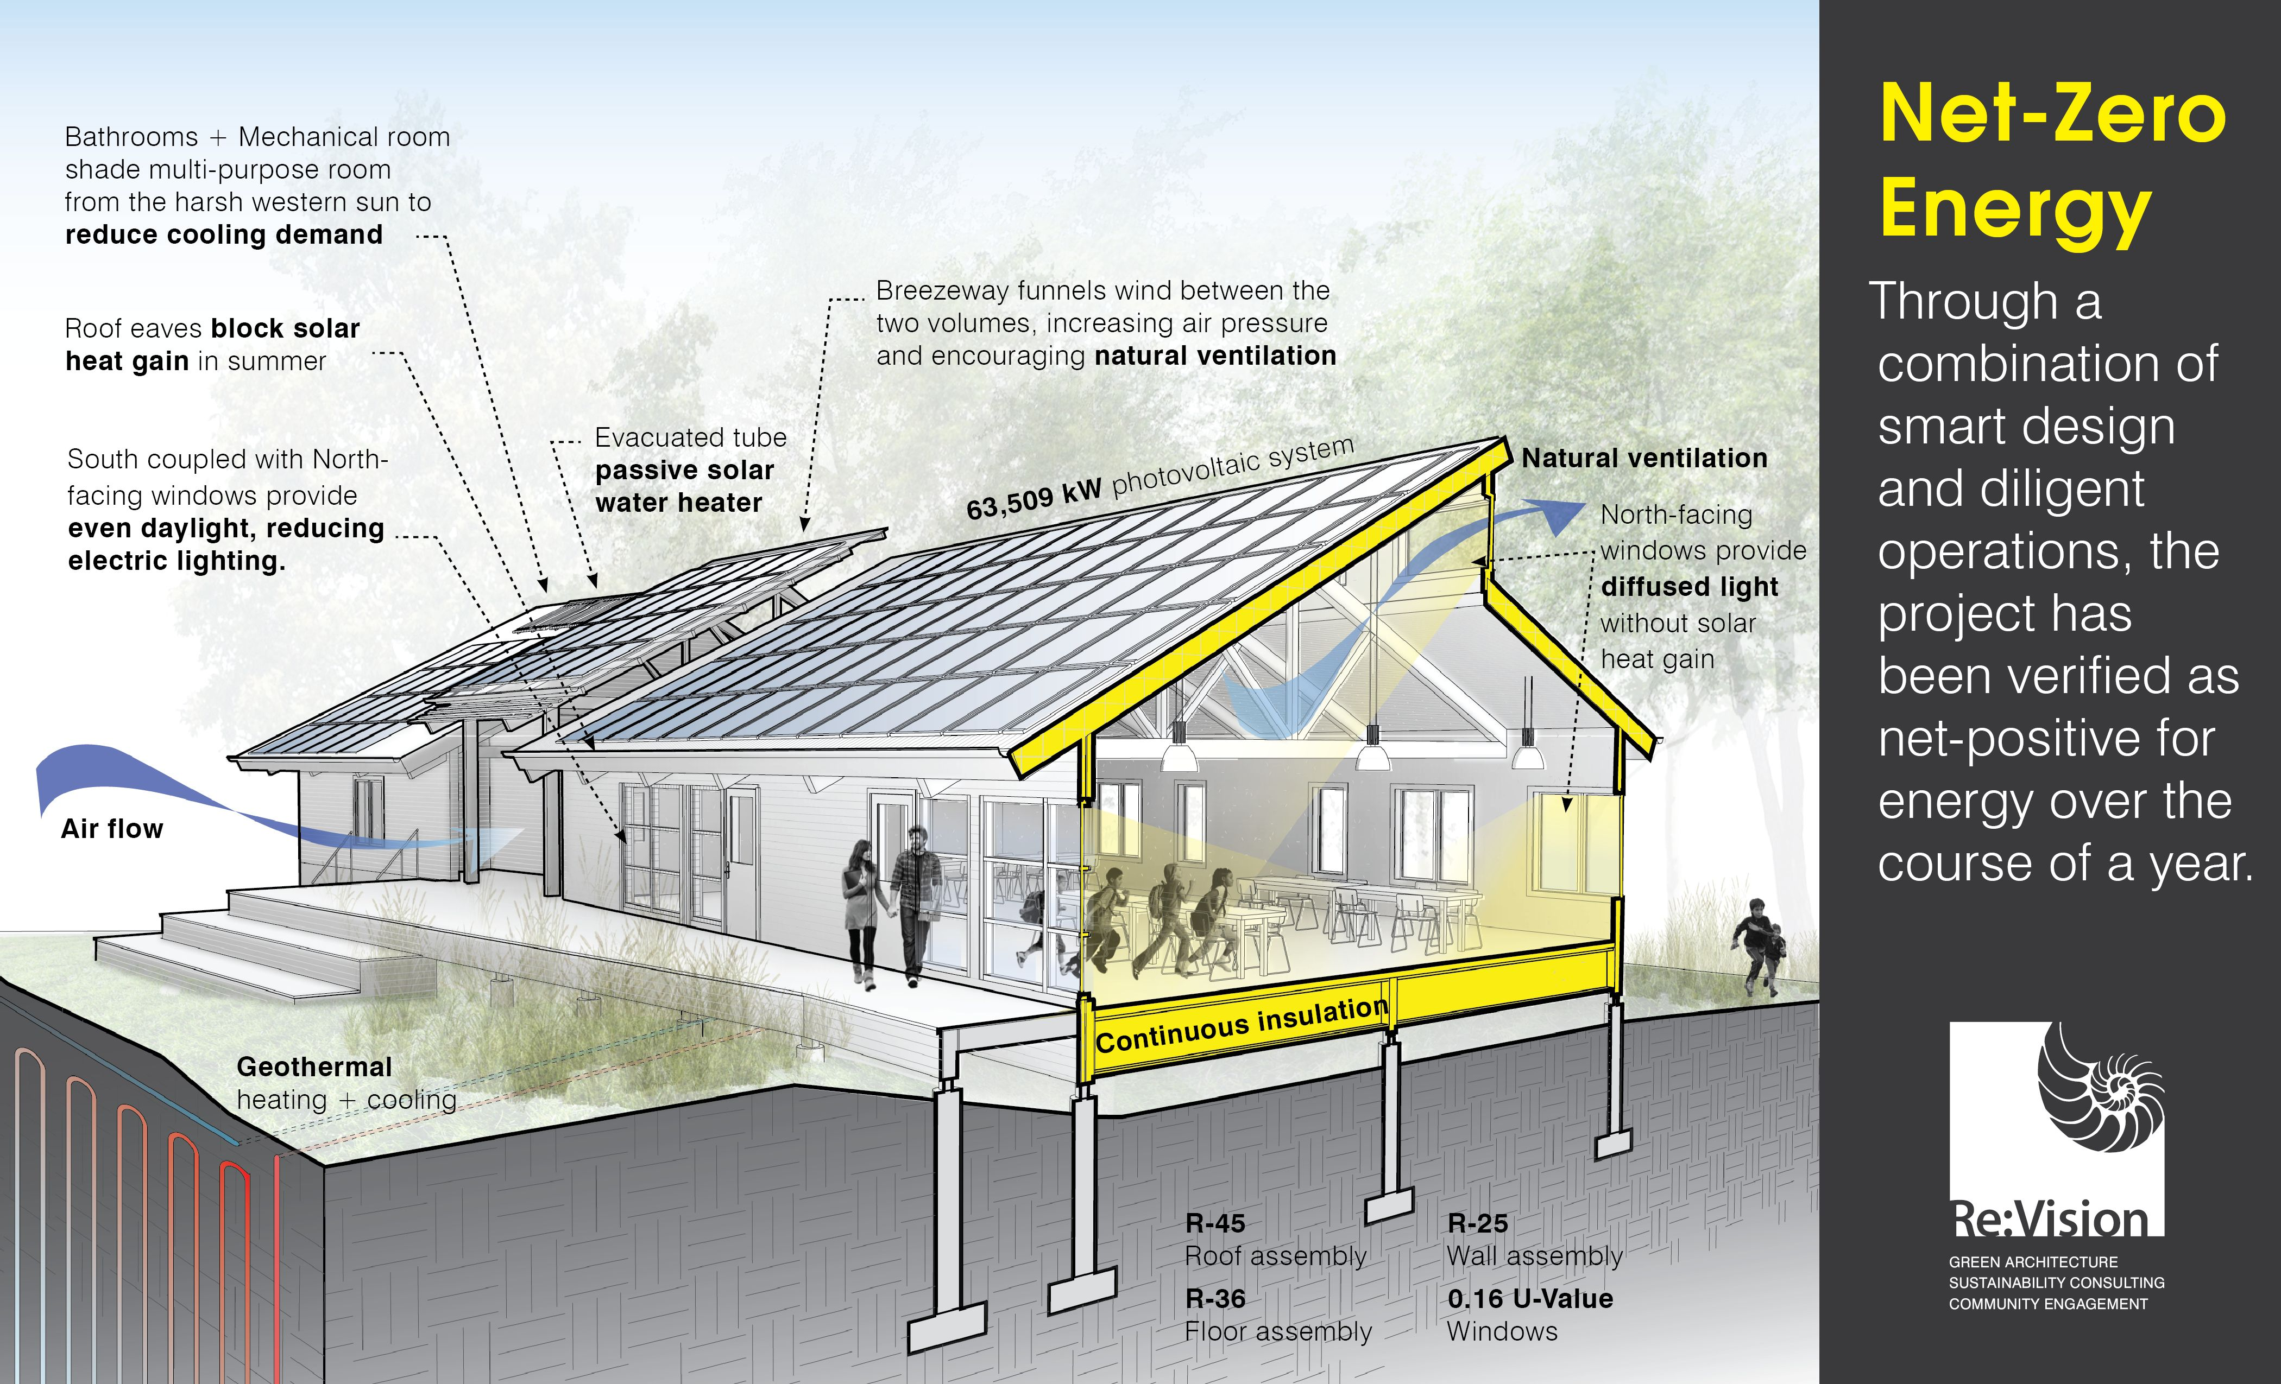
Future of Energy: Net-Zero Energy Building

Slide 43
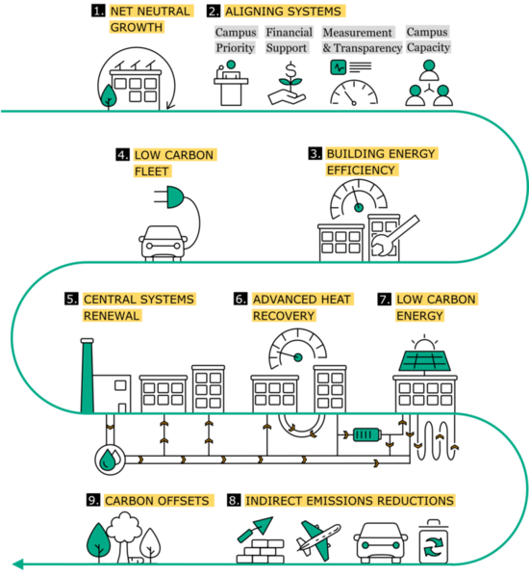
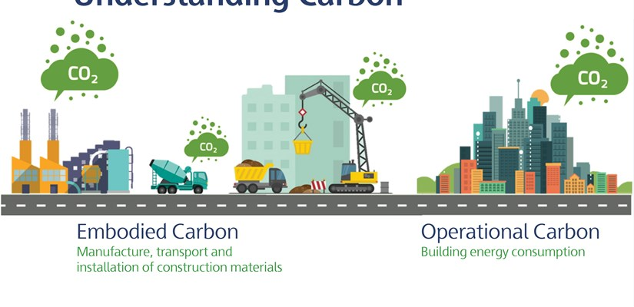
Future of Energy: Carbon Neutrality

Slide 44
Key environmental issues addressed by Green Building consultants
Materials:
  Material Certification (e.g. Environmental product declarations)
  Greenhouse gases and other emission
  Life-cycle analysis (LCA) & Life-cycle Cost Analysis (LCCA)
  Resource reuse
  Toxicity
  Waste diversion/recycling

Slide 45
Key environmental issues addressed by Green Building consultants
Air:
  Indoor Air Quality
  VOC Assessment
  HVAC Design

Slide 46
Key environmental issues addressed by Green Building consultants
Materials:
  Material Certification (e.g. Environmental product declarations)
  Greenhouse gases and other emission
  Life-cycle analysis (LCA) & Life-cycle Cost Analysis (LCCA)
  Resource reuse
  Toxicity
  Waste diversion/recycling

Slide 47
Key environmental issues addressed by Green Building consultants
Awareness/Facilitation/Implementation to the end user:
  Education in the form of training or presentations on green building
  Facilitation of strategic planning
  Facilitation of sustainable processes
  Facilitation of green building rating systems
  Implementation of sustainable or green building goals

Slide 48
Thank You!

